Slide 1

Hermes Logistics Presents
PetasosExpress
By Illia Popov, Ahmad Aljawish, William Margalik and Dylan Ashton

Slide 2
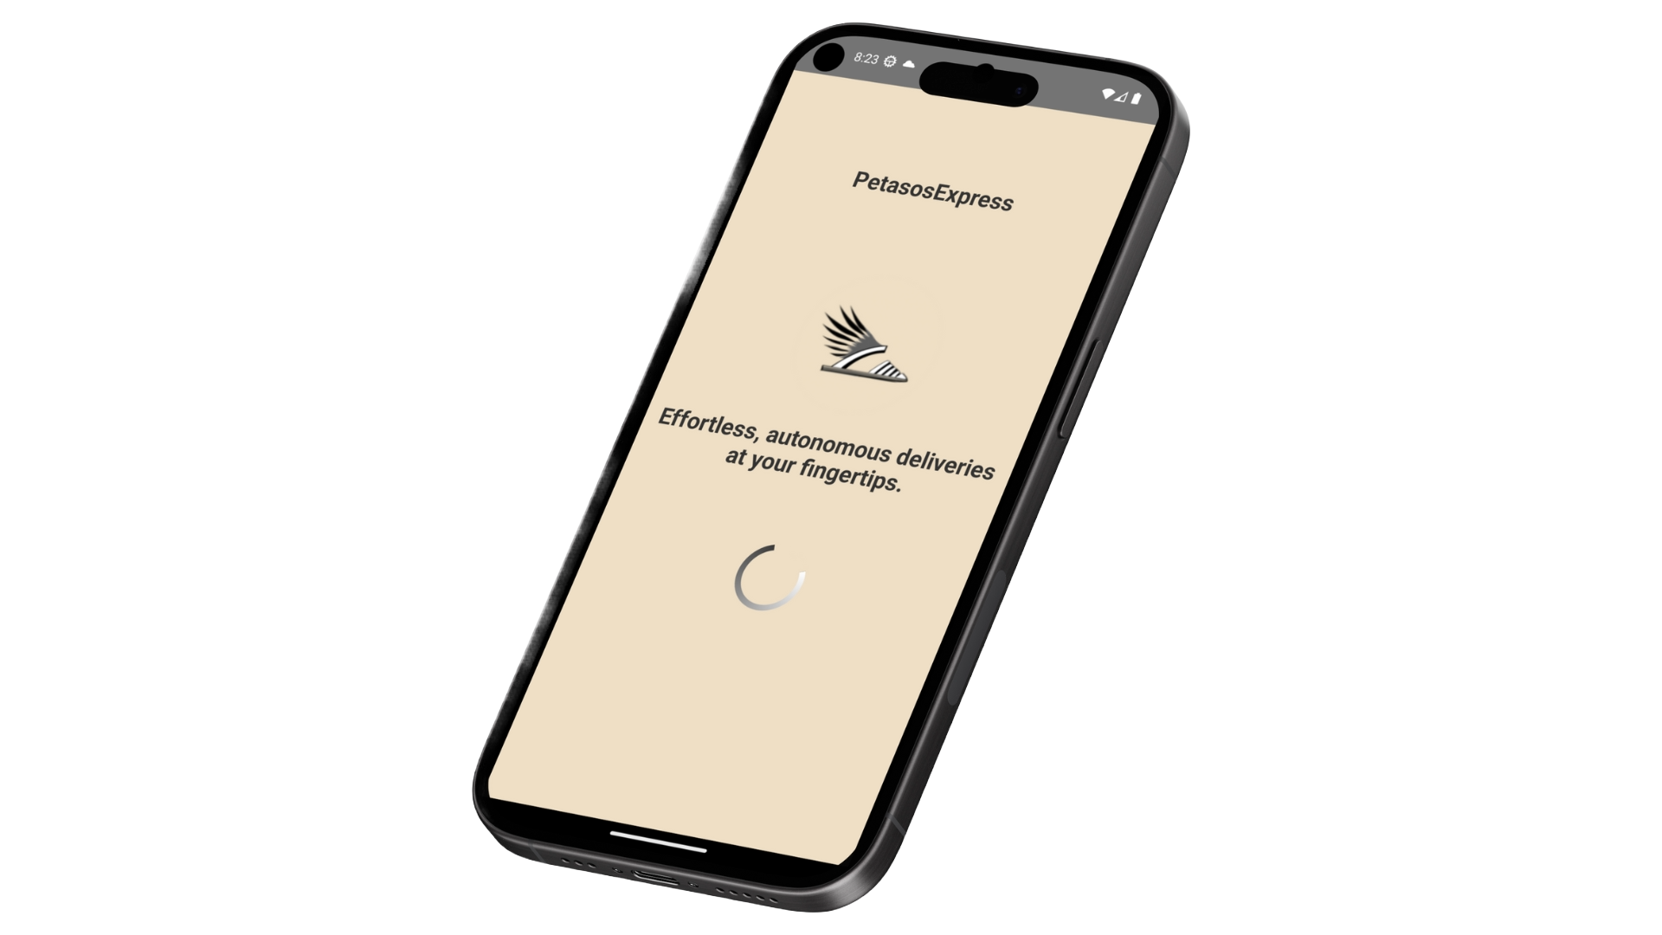
01
02
03
0405
Main Components of the Application
Authentication
The user can create an account with PetasosExpress or use Google to login
Shopping
The user can search for products add them to cart and purchase them.
Delivery Tracking
The user can track the delivery location and sensor readings of Petasos (delivery robot) assigned to their order
App Personalization
The user personalize the App and their Account for their liking.
Feedback loop
The user can submit their feedback to help us make the App better

Slide 3
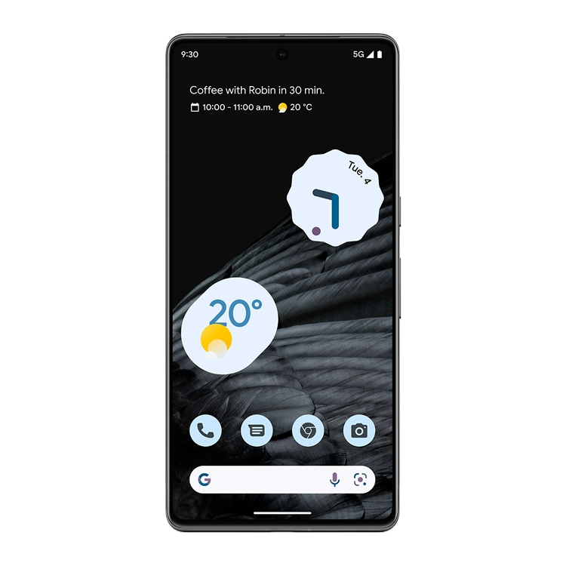
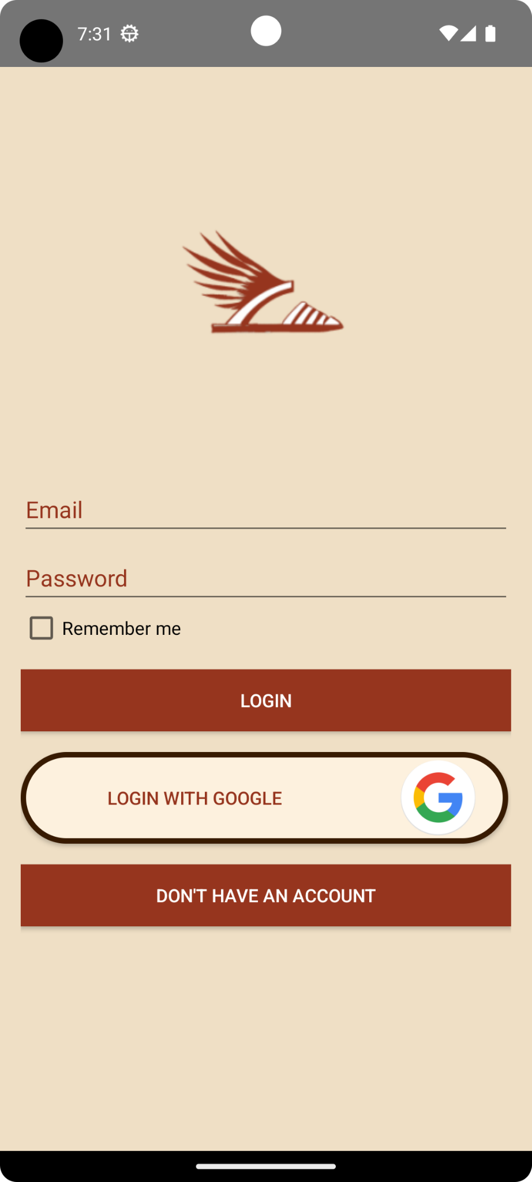
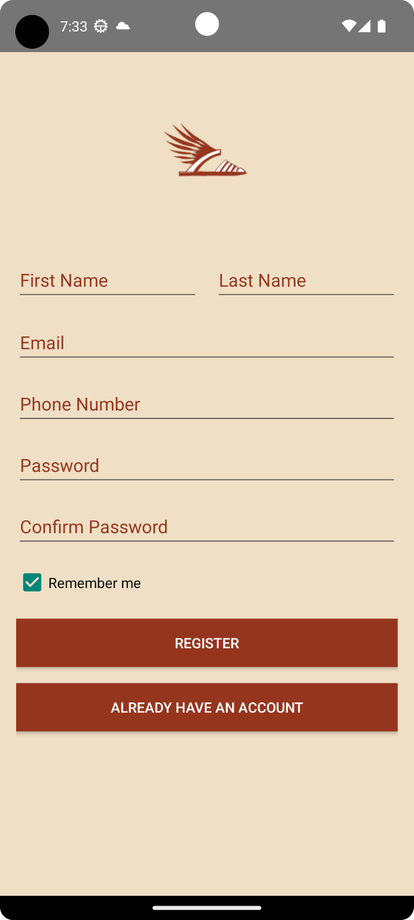
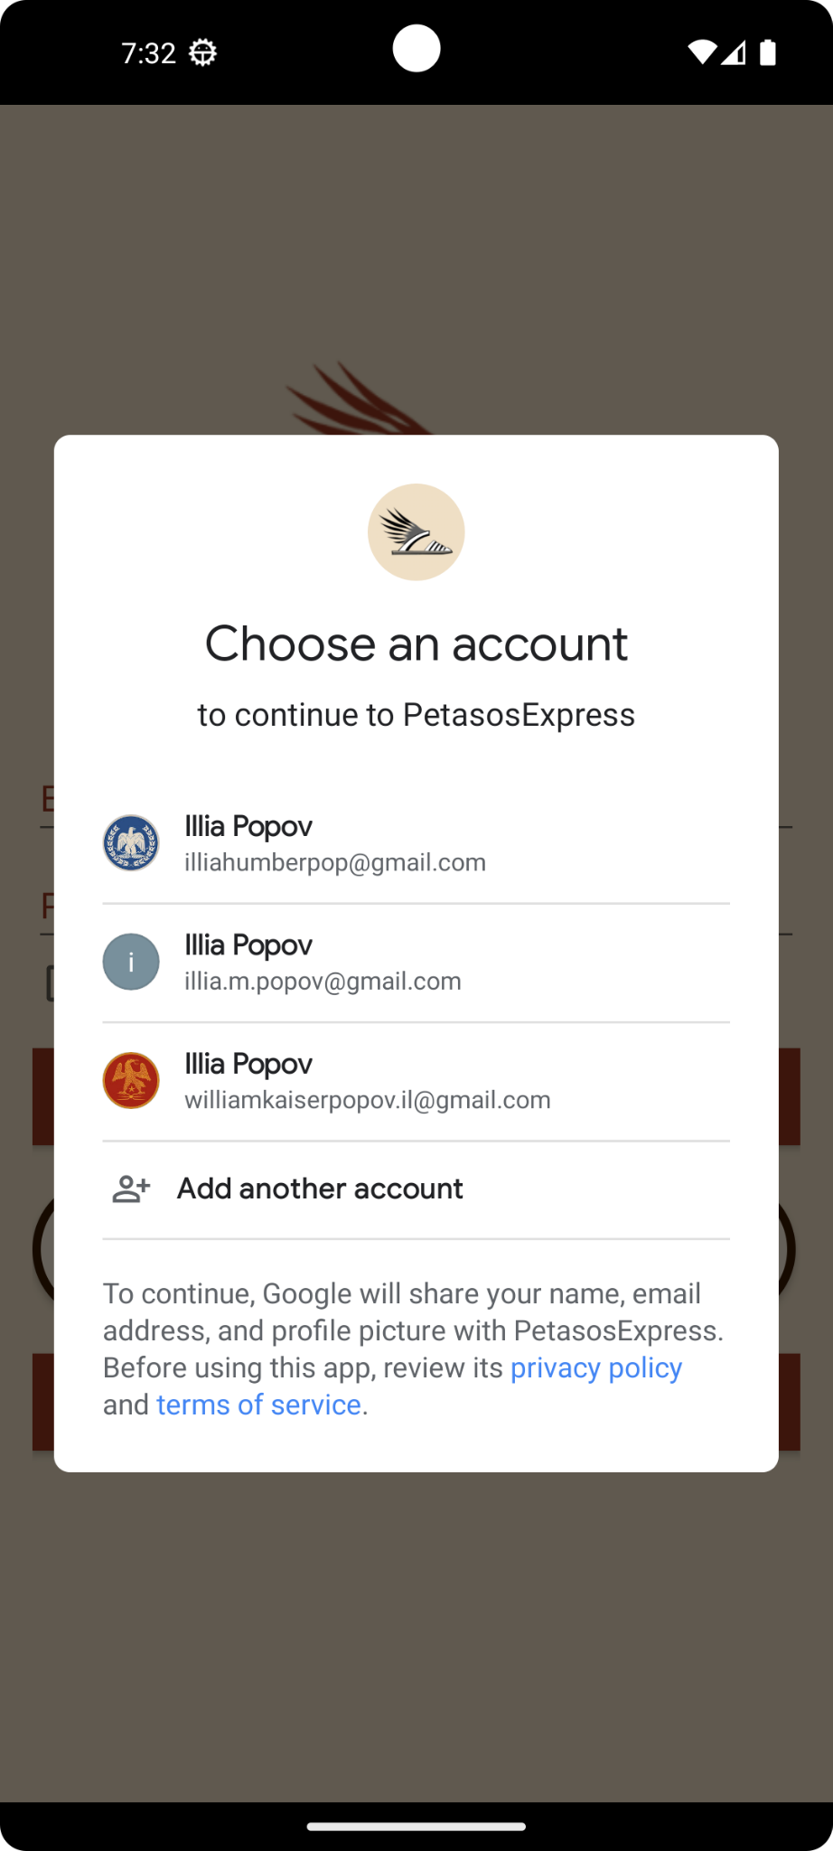
01
Authentication
Login
Login with Google
Registration

Slide 4
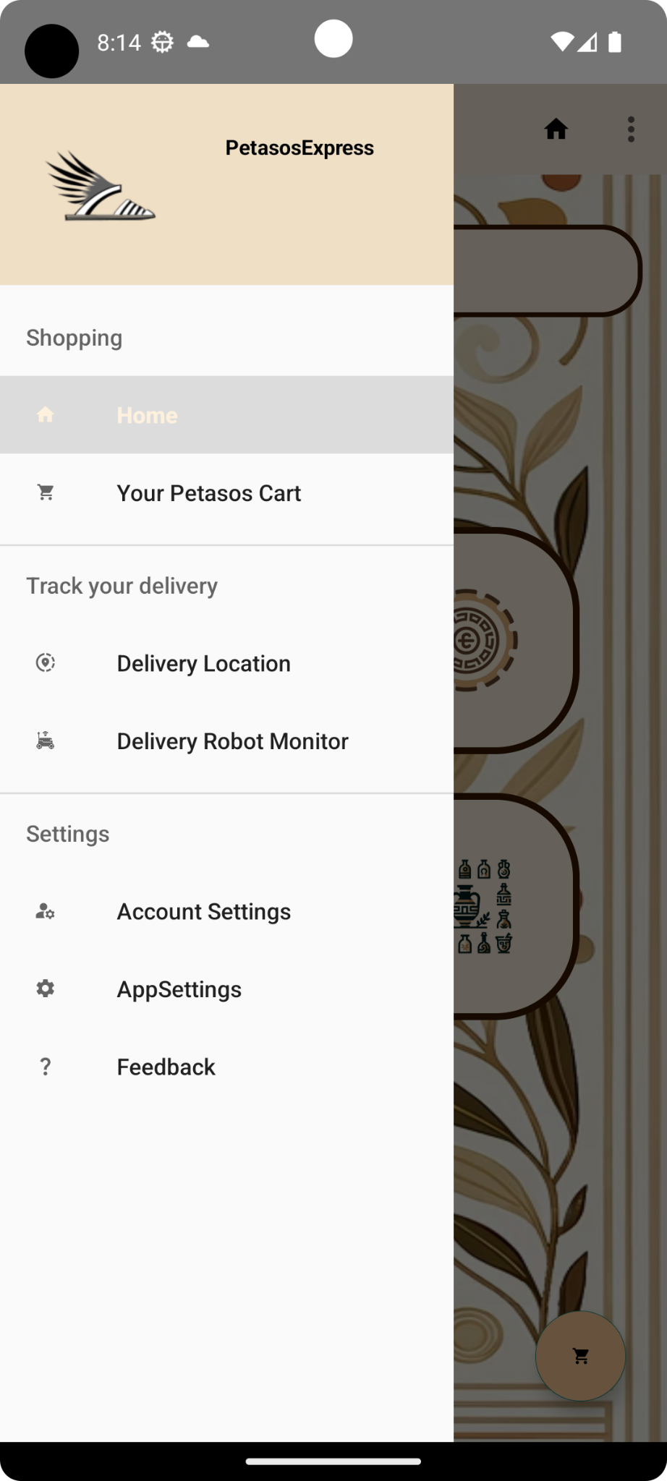
1.5
Navigation
Intuitive Access:
- Provides users easy access to diverse features like ordering, tracking, and sensor screens.
- Enhances user experience via intuitive, one-touch navigation.
Space-Efficient Design:
- Optimizes screen space by neatly organizing functions in a hidden drawer.
- Maintains a clutter-free layout, ensuring seamless user interaction.

Slide 5
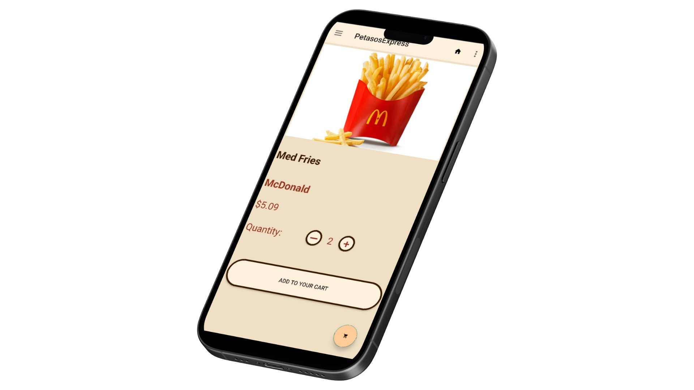
02
Shopping
How to shop and buy things!

Slide 6
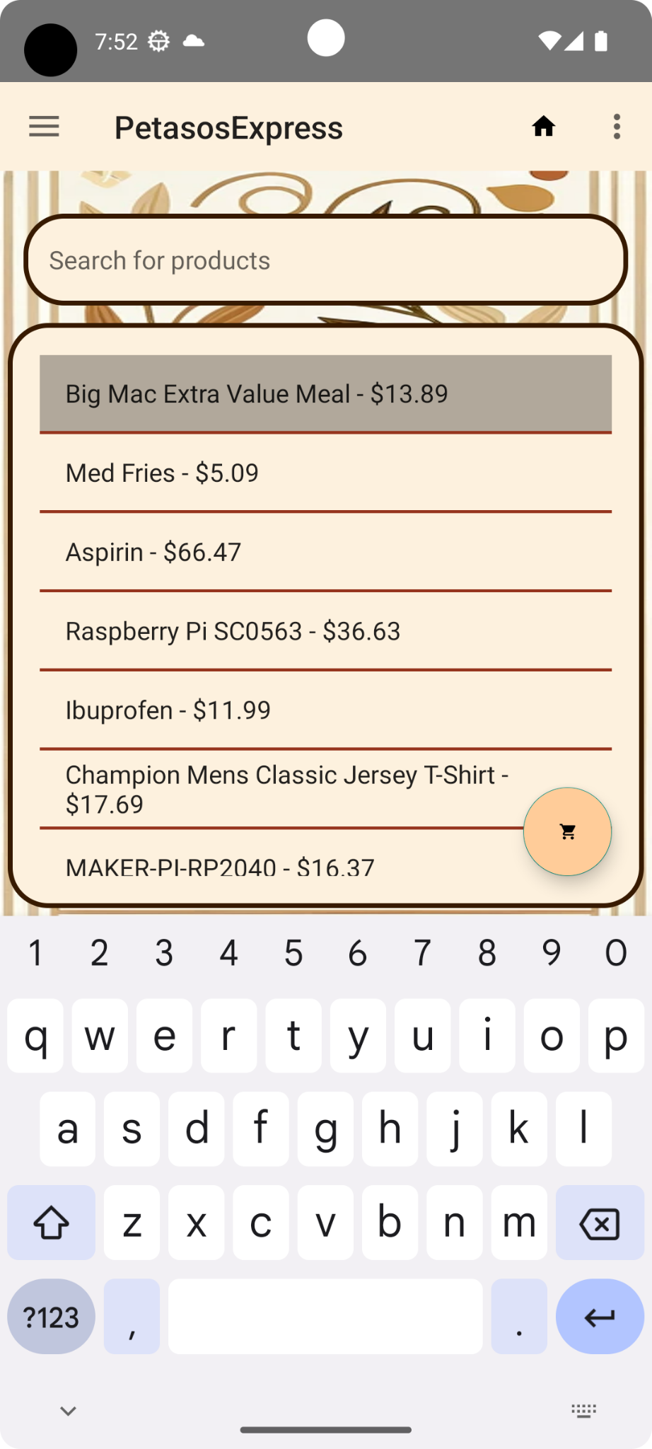
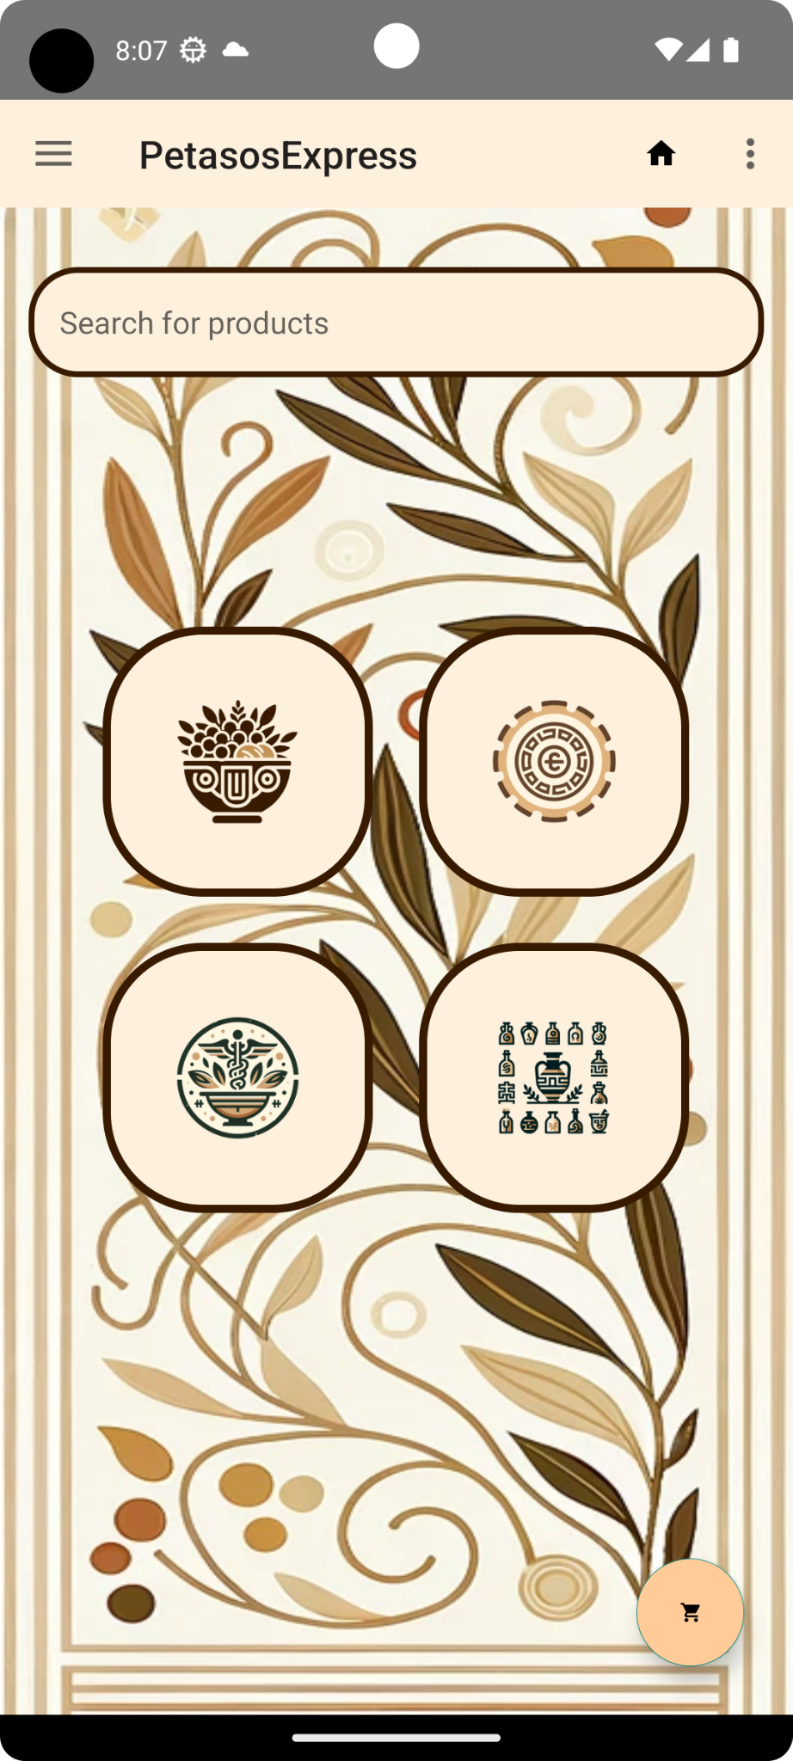
Search for Products!
Home & Search Screens
On the home screen users can type what they are looking for in the search tab to fo to the search screen or click on one of the buttons filter specific type of products.
Users can search for the items by product’s name, type or producer to find exactly what they need!
Our Search engine uses our database of approved products to fetch information about items’ names, prices, category, etc,and display it on the search screen.

Slide 7
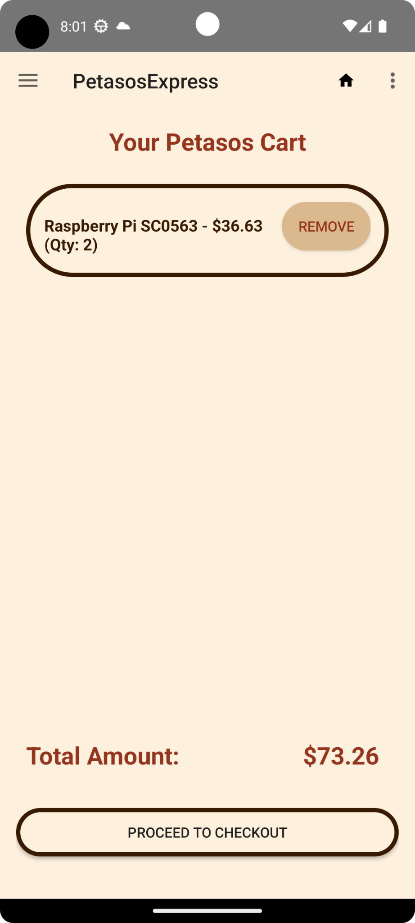
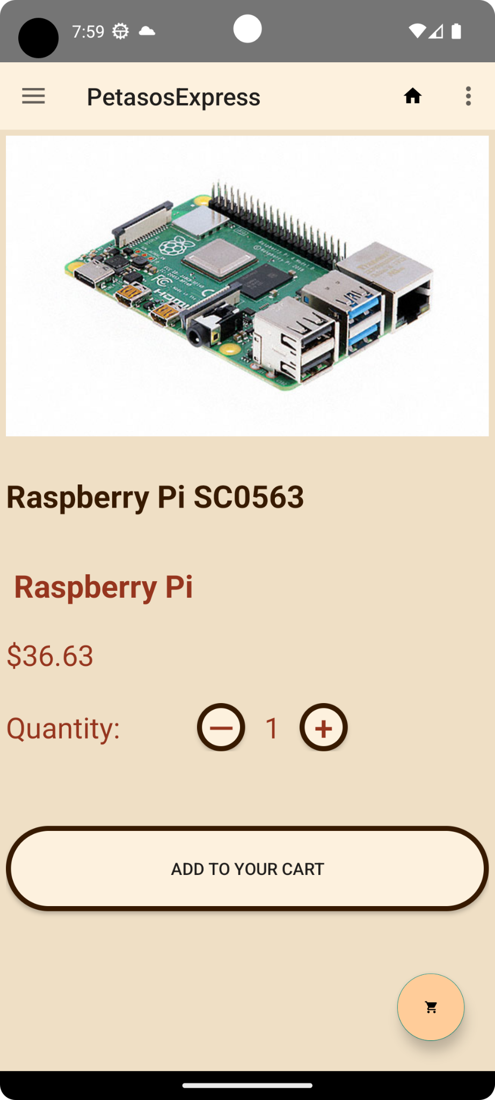
Add them to your cart!
Cart Screen
Product Screen
On the product screen user can get more information about the product. Even check at how it looks!
Users can chose the quantity of items they want to add to their cart and go there right away using FAB!
On the cart screen user can make final decision if they want to remove something before proceeding to checkout.

Slide 8
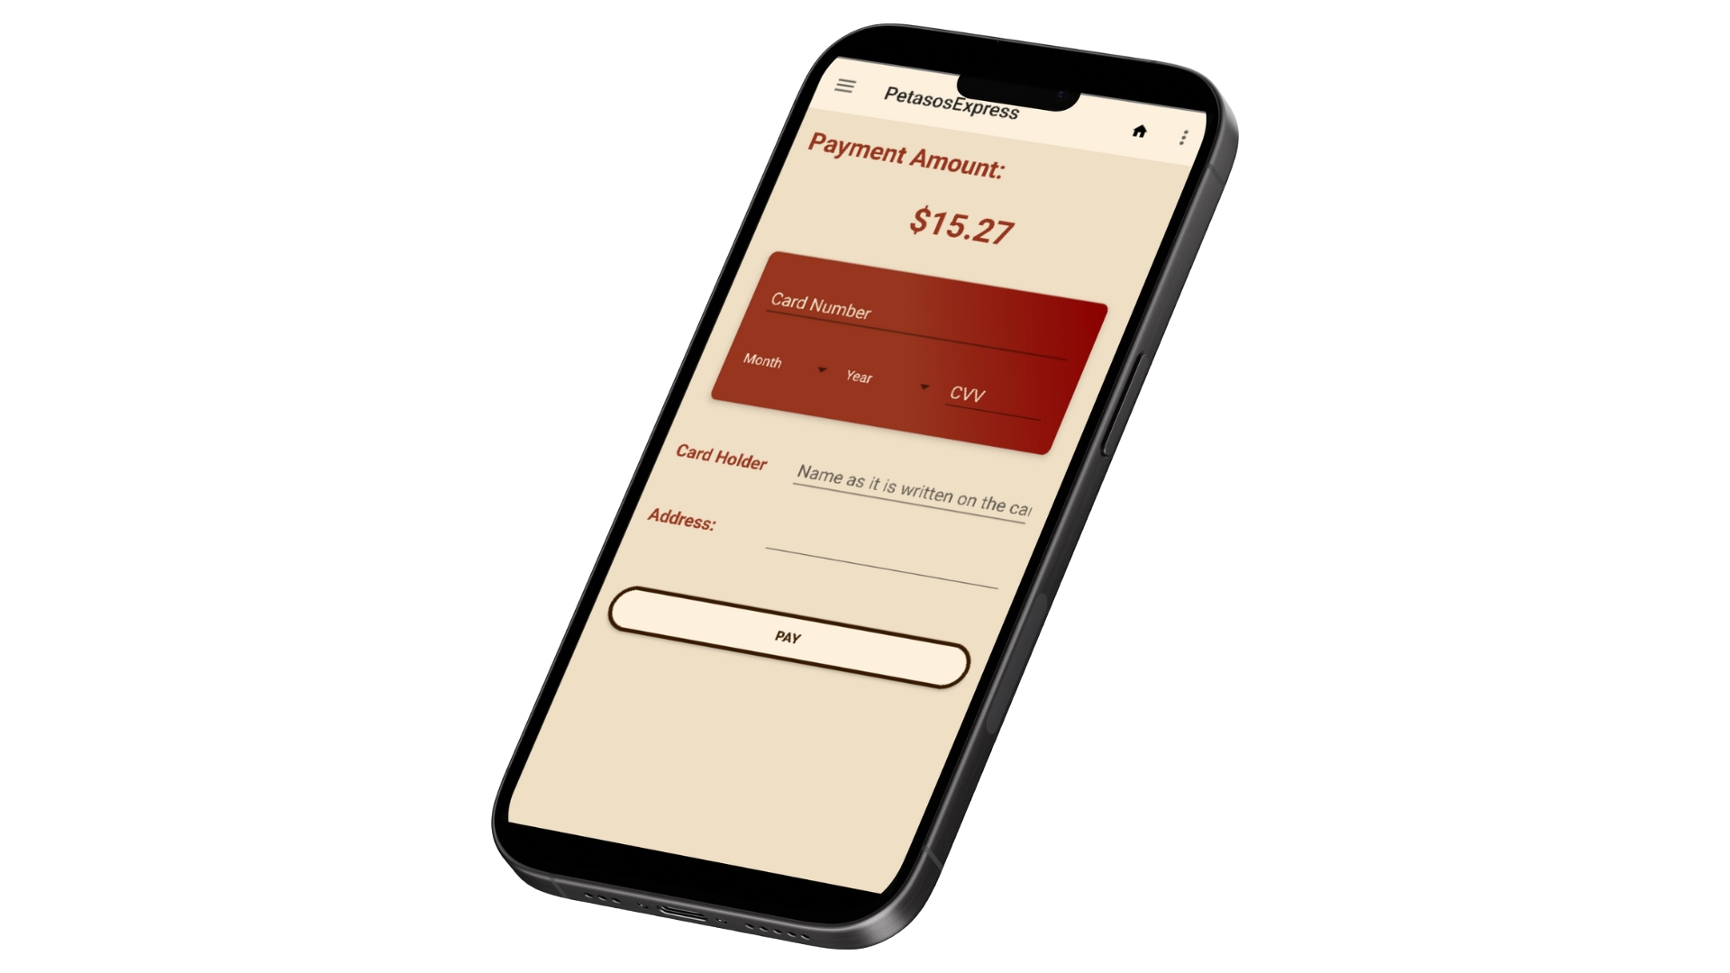
Place your order!
Payment Screen
Finally users can pay for their order! Card number, Expiration date, CVV, card Holder Name and Address should be filled to assign the order.

Slide 9
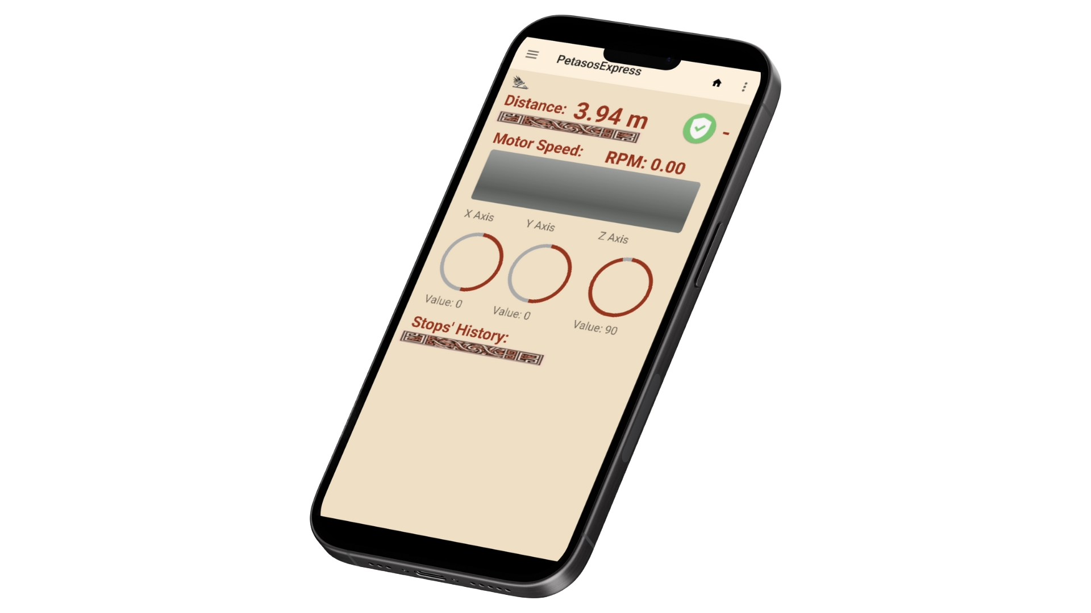
03
Delivery Tracking
Track your order!

Slide 10
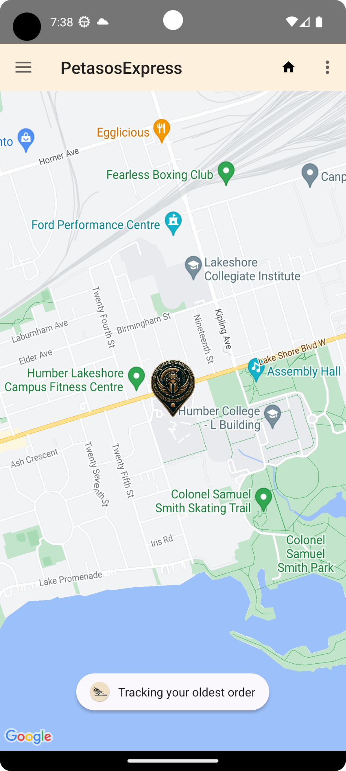
Tracking Location of the delivery
Geolocation Screen
After the order was placed users can track location of the delivery robot using “Delievry Location” screen to know exactly how close their delivery is to them!

Slide 11
Tracking Petasos Condition
Proximity/Distance
Motor Speed in RPM
Magnetometer for tilt and direction
Stops History

Slide 12
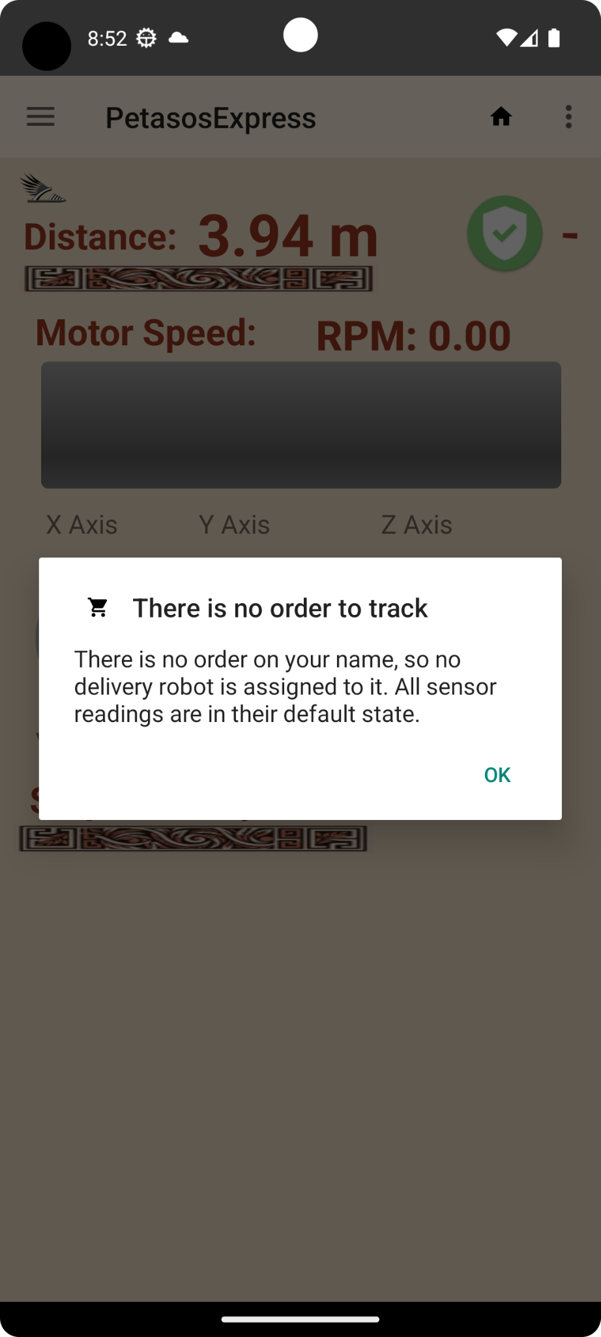
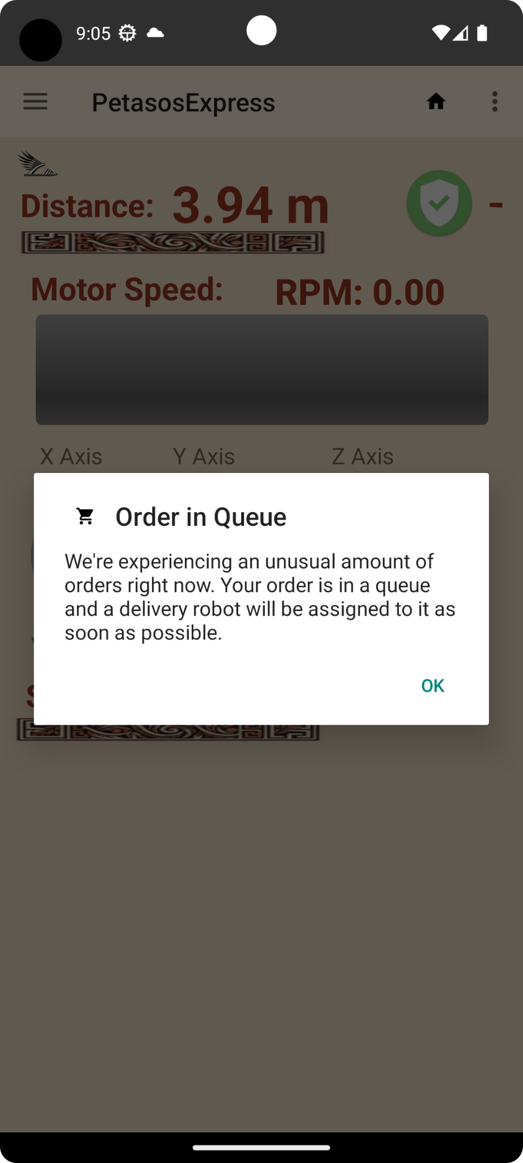
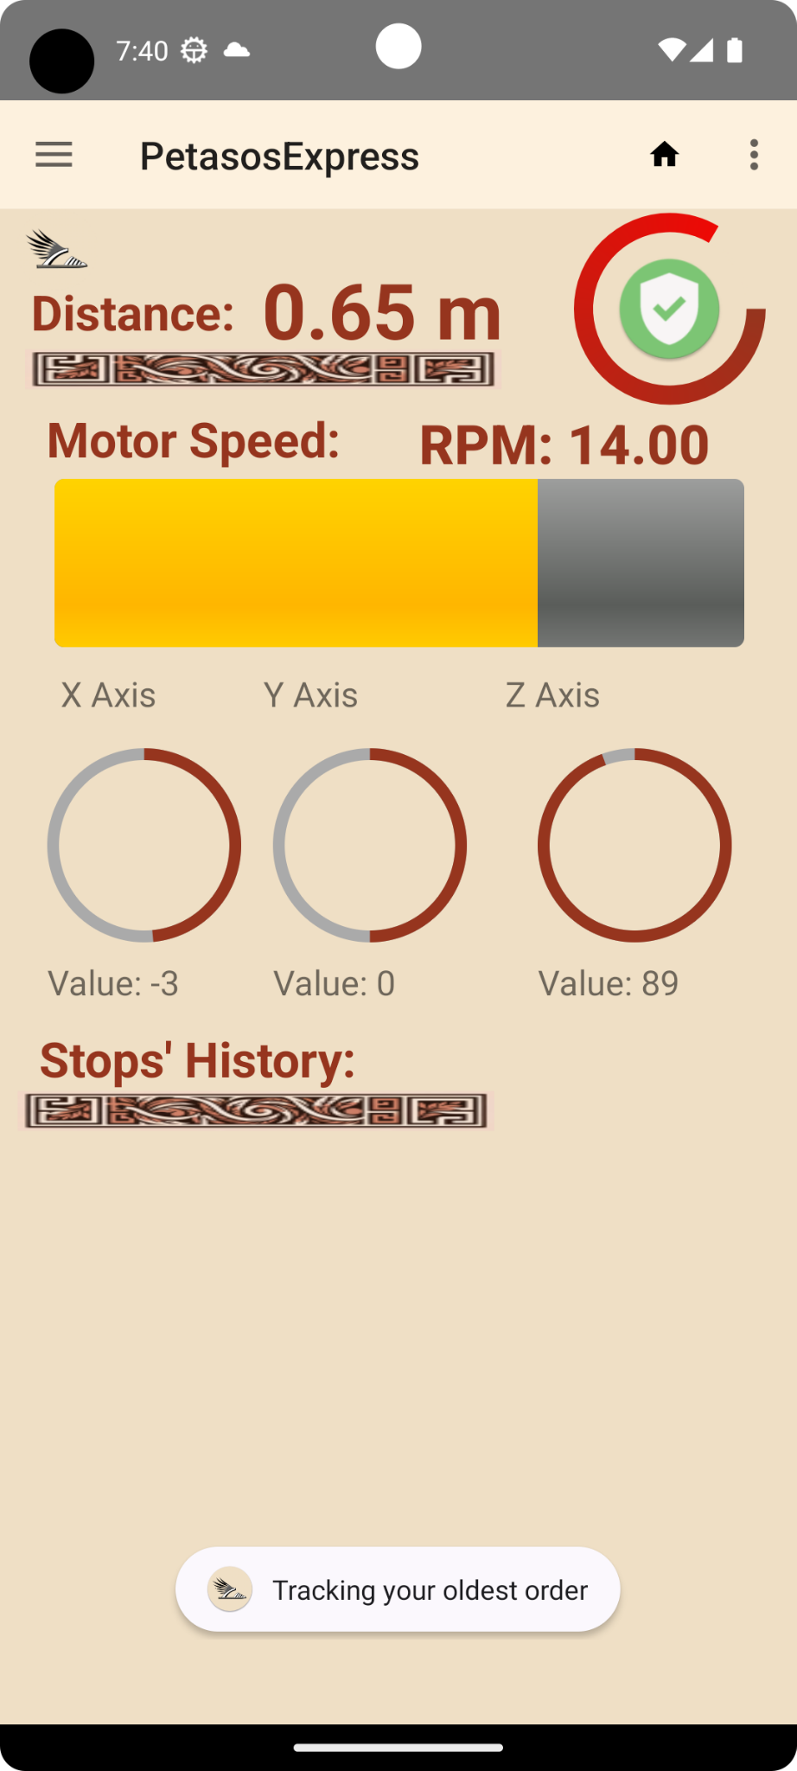
Tracking works only there is something to track!

Slide 13
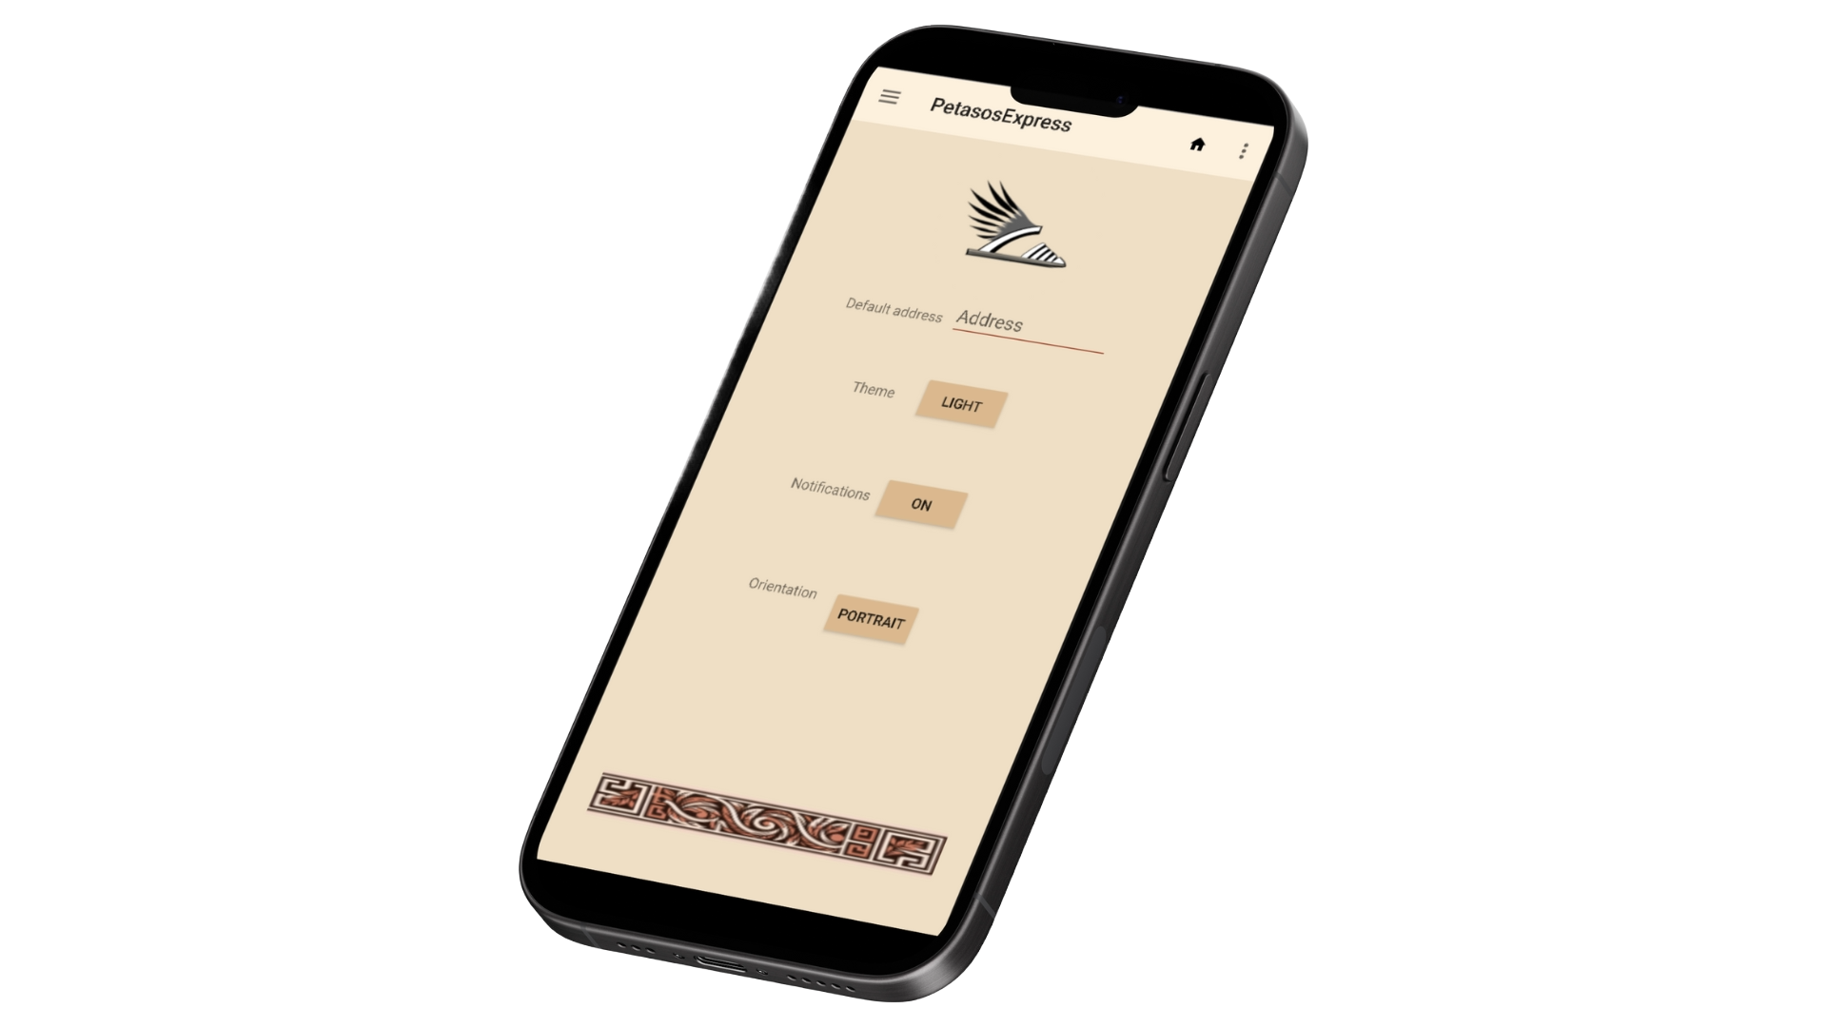
04
Personalization Petasos
Personalize your Petasos

Slide 14
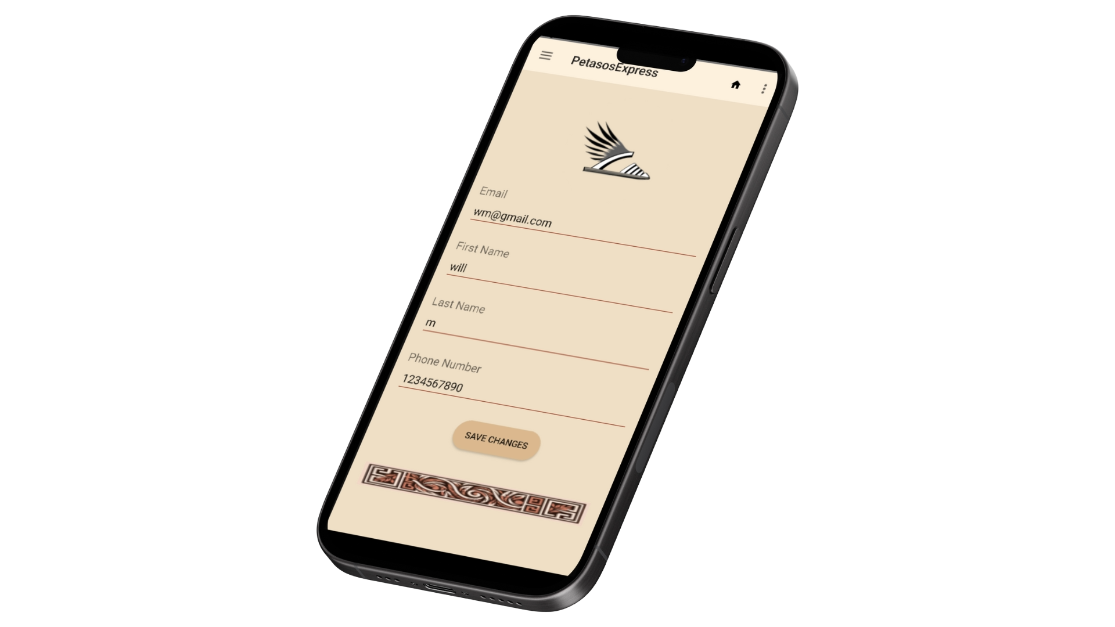
Manage Account
Manage Account screen :
Email Display: Shows the user's current email address, helping them to verify their account identity.
Personal Information Update: Allows users to edit and save their first name, last name, and phone number, ensuring their profile is up-to-date.
Phone Number Formatting: Automatically removes non-numeric characters from the phone input, maintaining a standardized format for contact information.
Data Validation: Includes checks for empty fields and correct phone number length, ensuring all entered information is valid before saving.
User Feedback: Displays Toast messages for successful data updates or errors, providing immediate feedback on user actions.

Slide 15
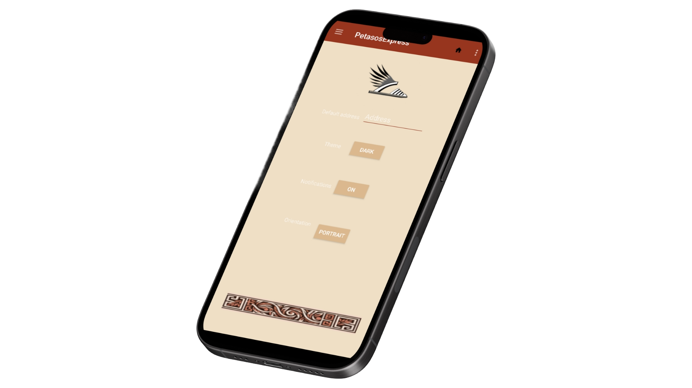
App Settings
Settings Screen:
Notifications Control: switch notifications on/off for personalized updates.
Location Selection: Customize app content based on city location.
Visual Preferences: toggle between dark mode and light mode effortlessly.
Orientation Choice: Opt for preferred screen orientation: portrait or landscape.

Slide 16
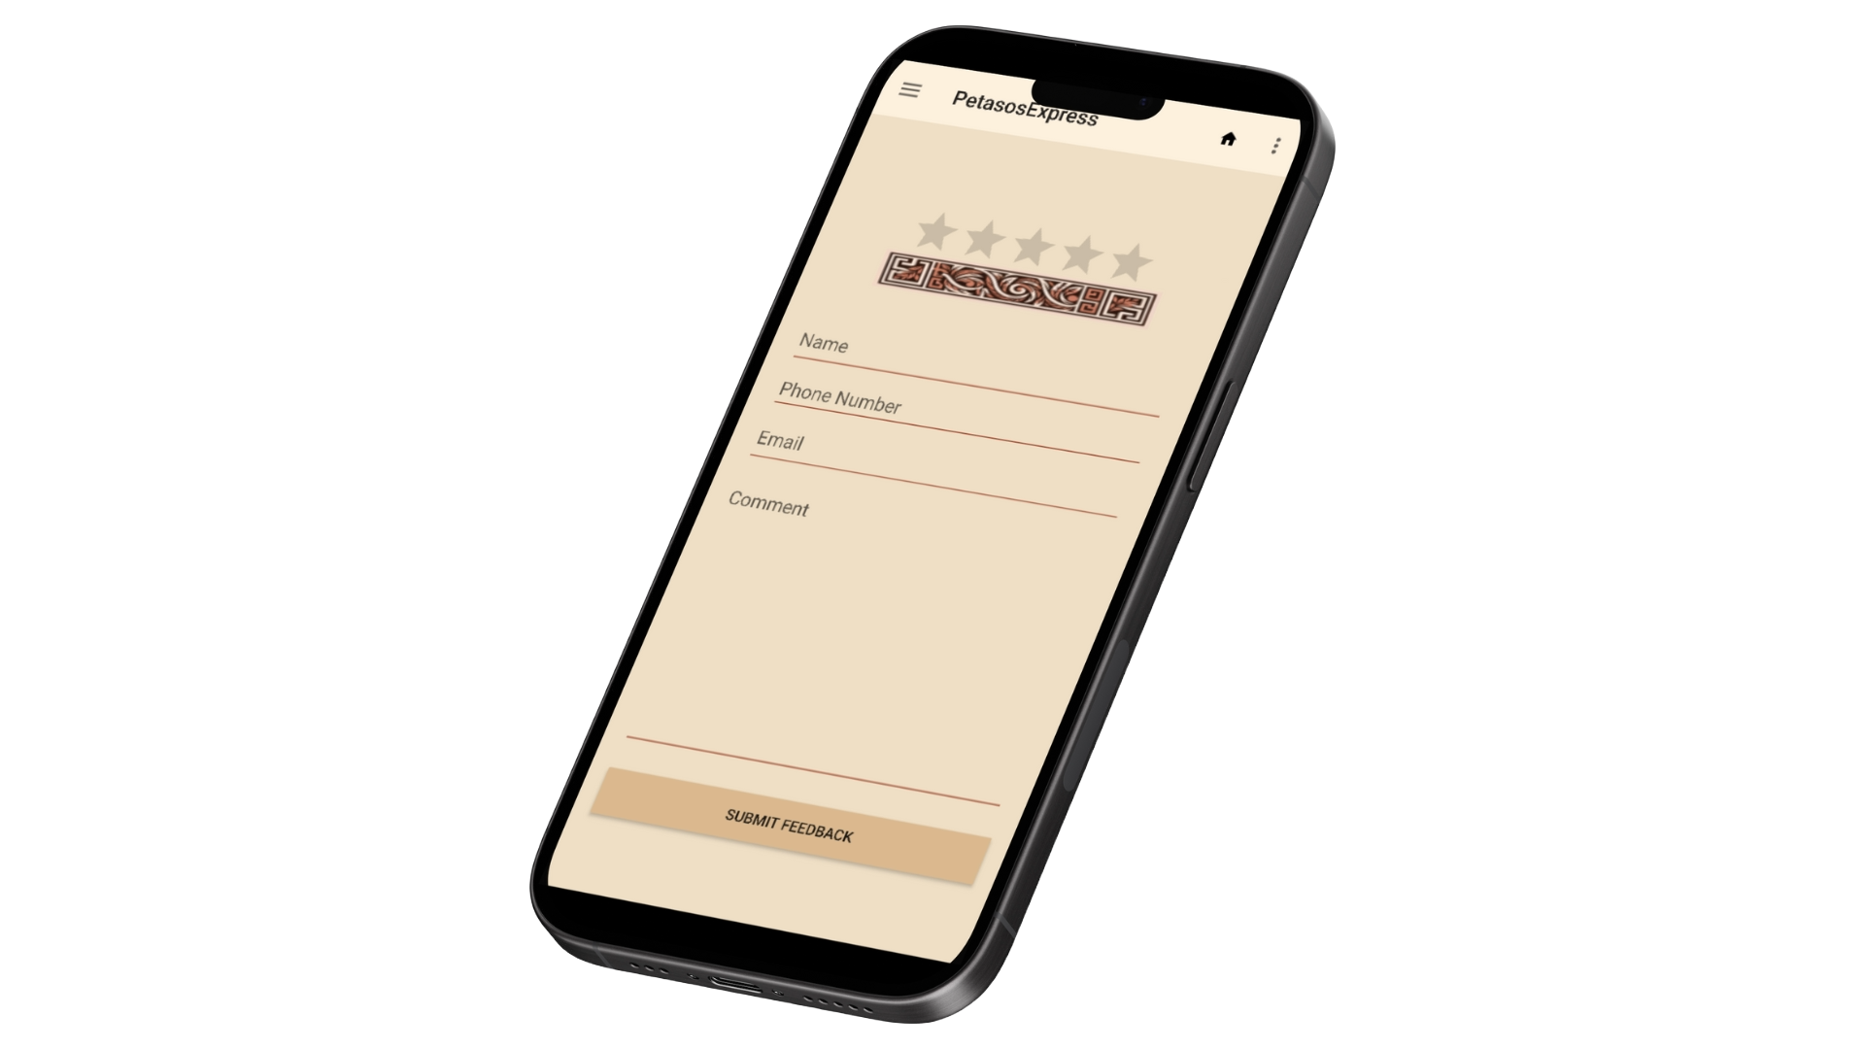
05
Feedback
Contact us, let’s make PetasosExpress better together!

Slide 17
Feedback page
Star Rating system
Store feedback and respond
Responsive UI
Unique responses

Slide 18
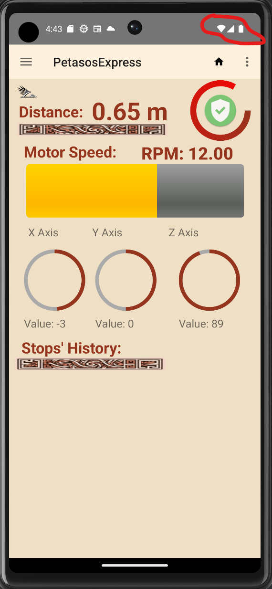
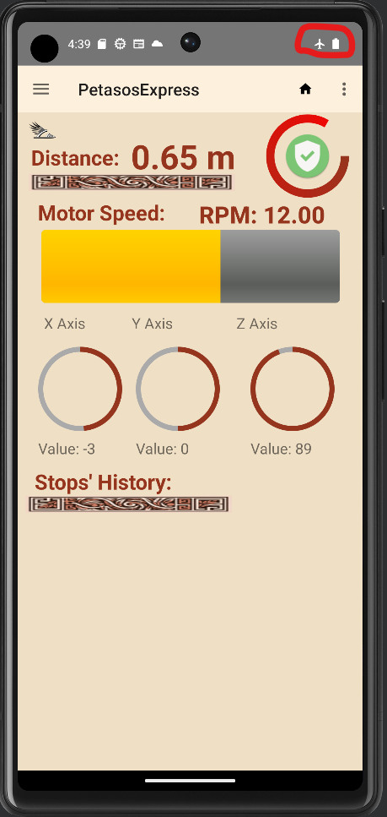
Offline Mode

Slide 19
How did we test:

Slide 20
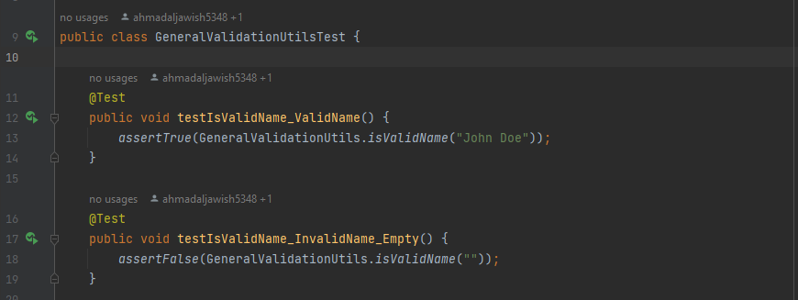
Junit Test cases

Slide 21
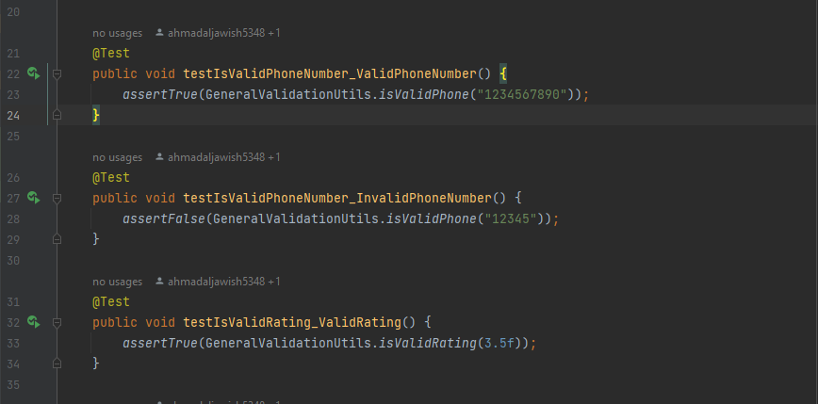
Junit Test cases

Slide 22
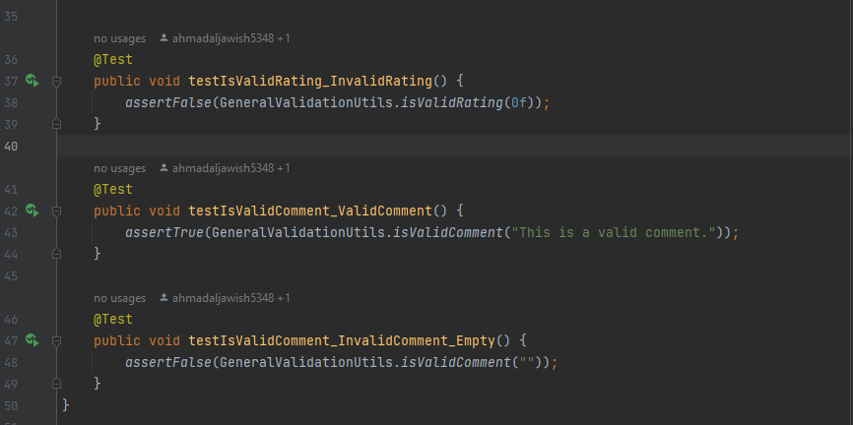
Junit Test cases

Slide 23
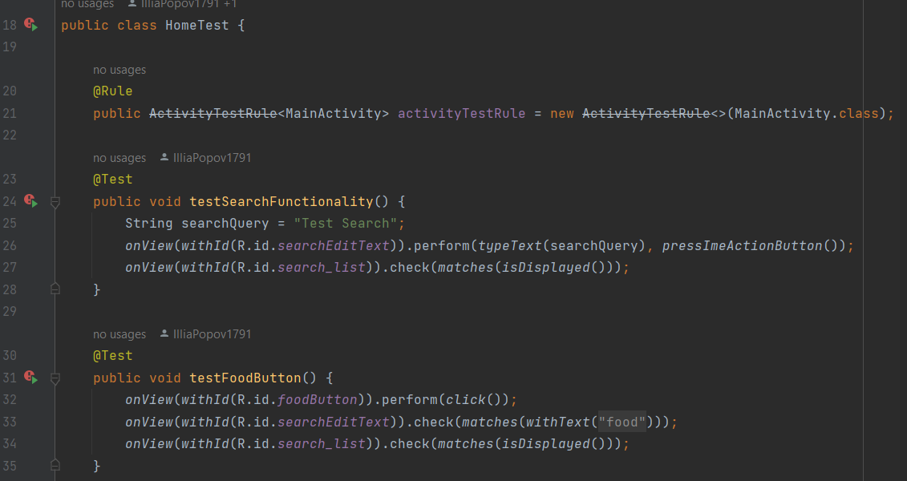
Espresso Test cases

Slide 24
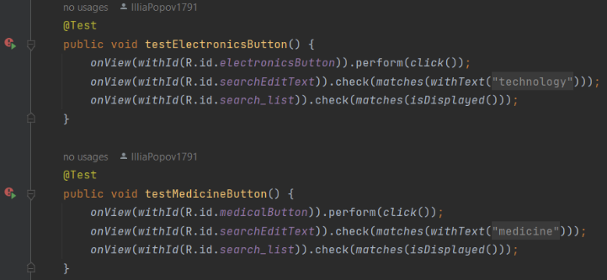
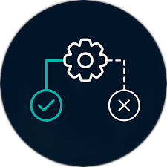
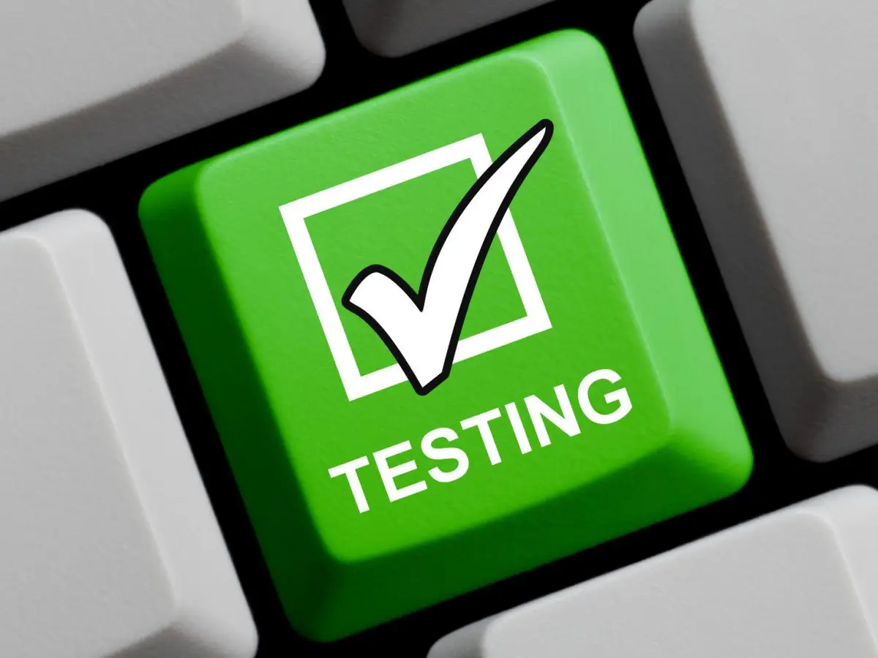
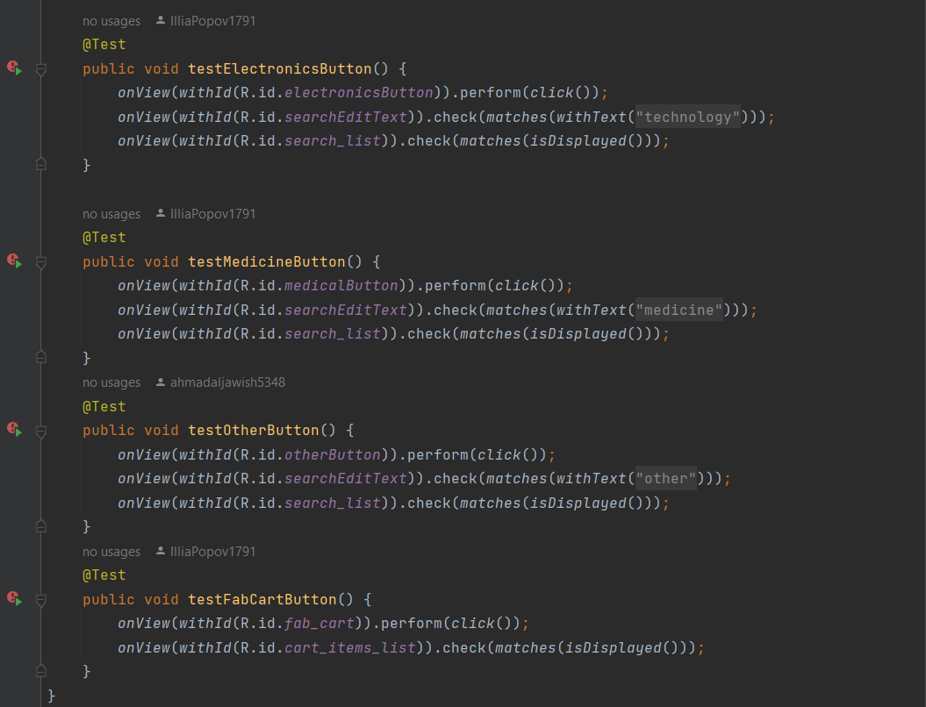
Espresso Test cases

Slide 25
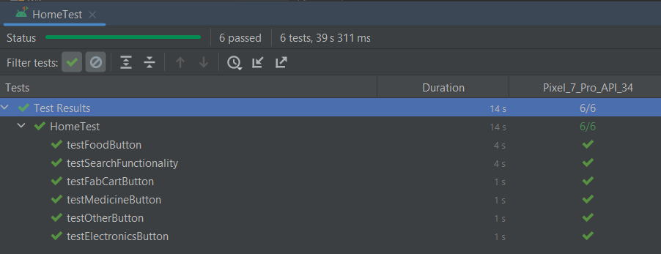
Espresso Test cases

Slide 26
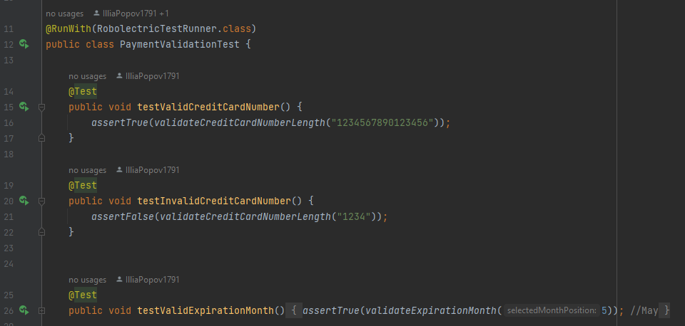
Robletric Test cases

Slide 27
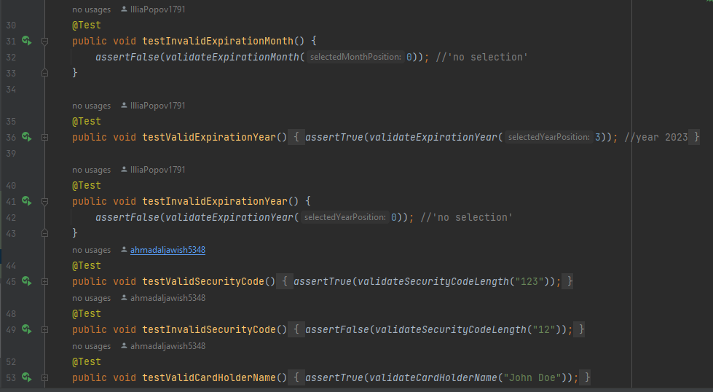
Robletric Test cases

Slide 28
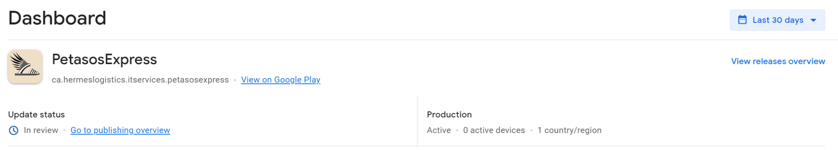

Submission To Google Play
App has been submitted to google play on 05/12/2023
Currently waiting on google to publish the App after reviewing

Slide 29
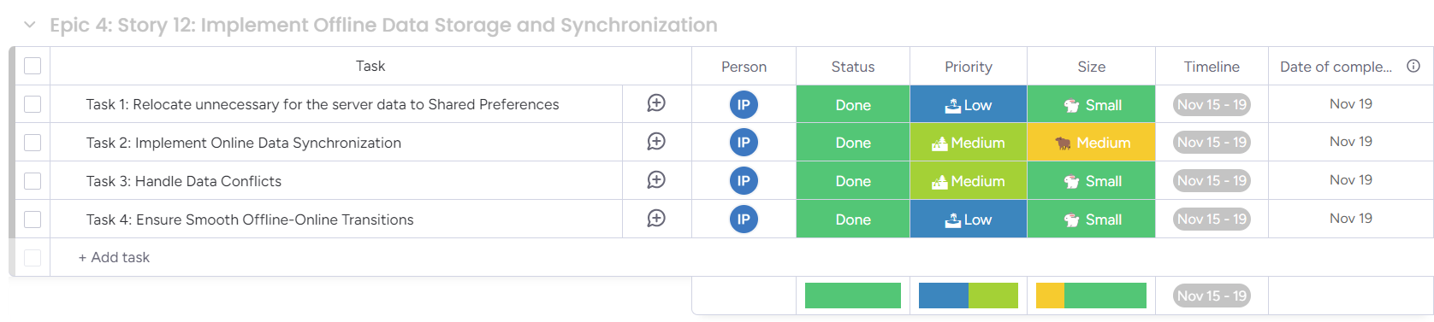
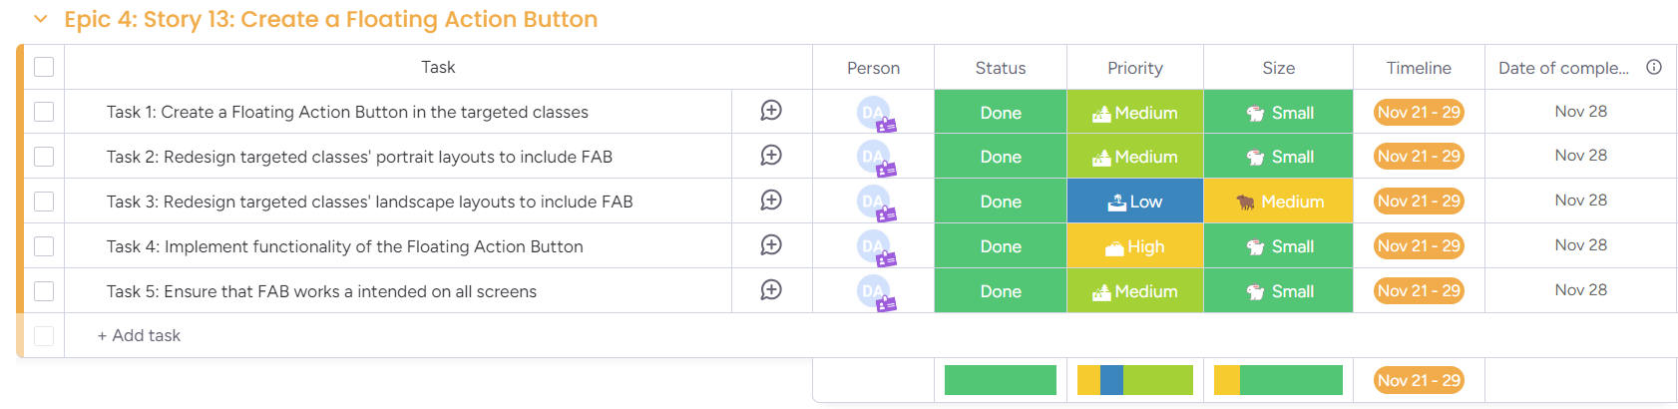
Sprints:

Slide 30
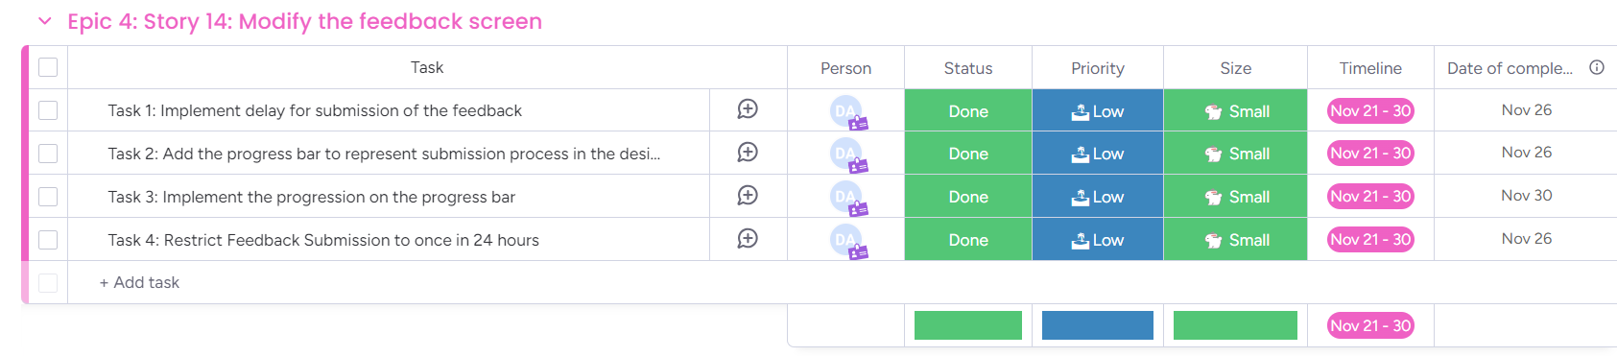
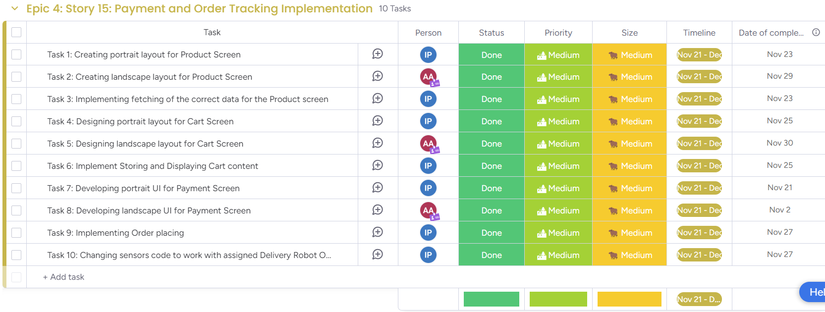
Sprints:

Slide 31
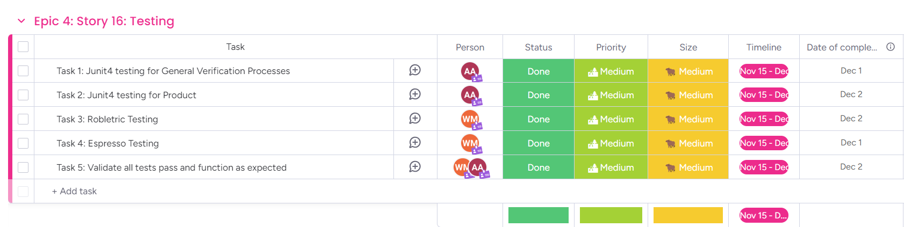
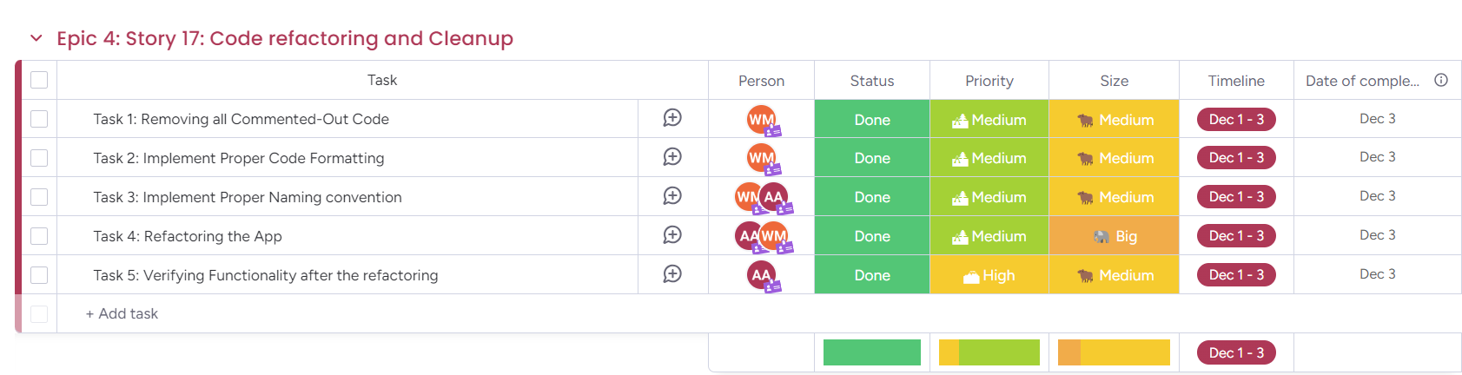
Sprints:

Slide 32
THANK YOU

Slide 33
